Slide 1

Saudi Arabia Used Car Sales
Milestone 2
“A car is an item that reflects the personality of its owner”
Notes:
Good Morning , First of all Thank you mr Danu for gave me the opportunity to present my milestone regarding Saudi Arabia Used Car Sales

Slide 2
Table of contents
01
02
Problem Case
03
04
About Data
Exploratory Data Analysis
Data Pre-processing
05
06
Model & Deployment
Conclusion
Notes:
In this presentation, I will divide it into 6 parts, namely Problem Case, About Data, Exploratory Data Analysis, Data Pre-processing, Model & Deployment, and Conclusion

Slide 3
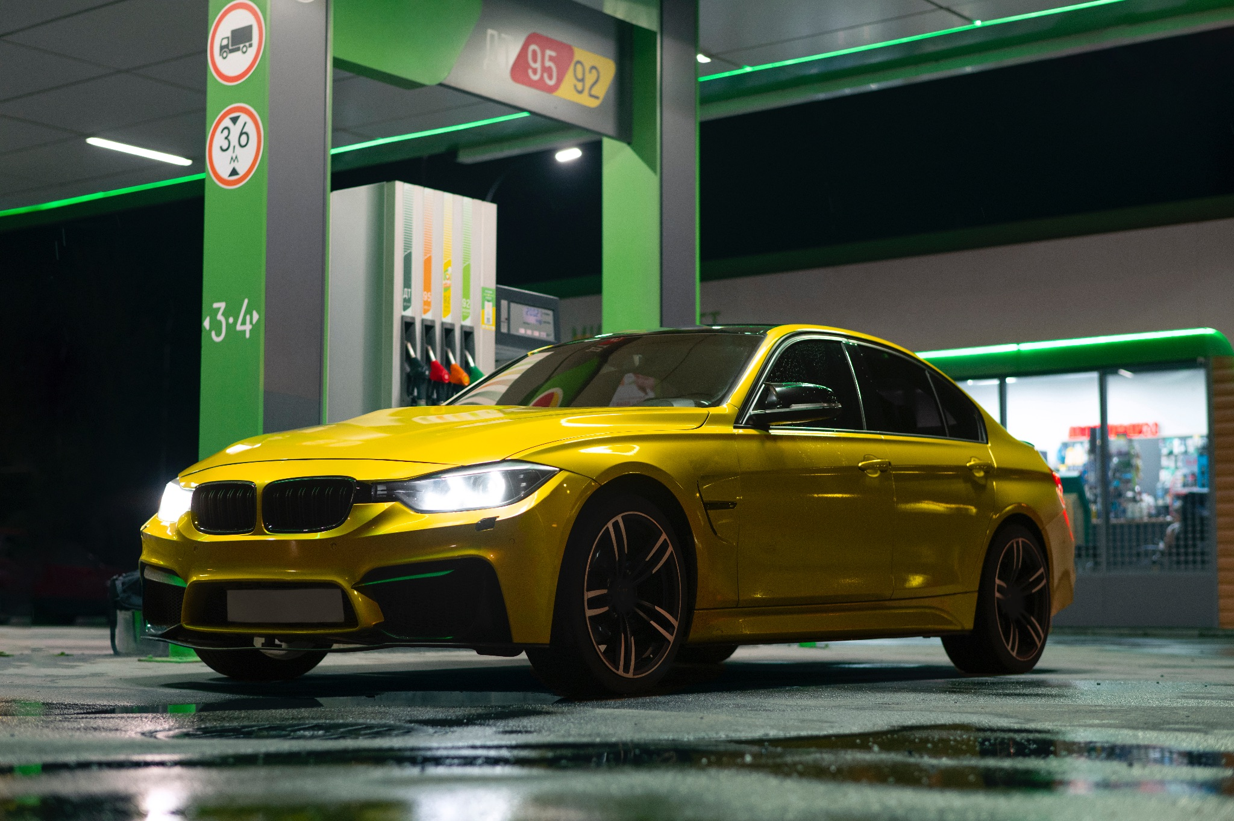
01
Problem Case

Slide 4
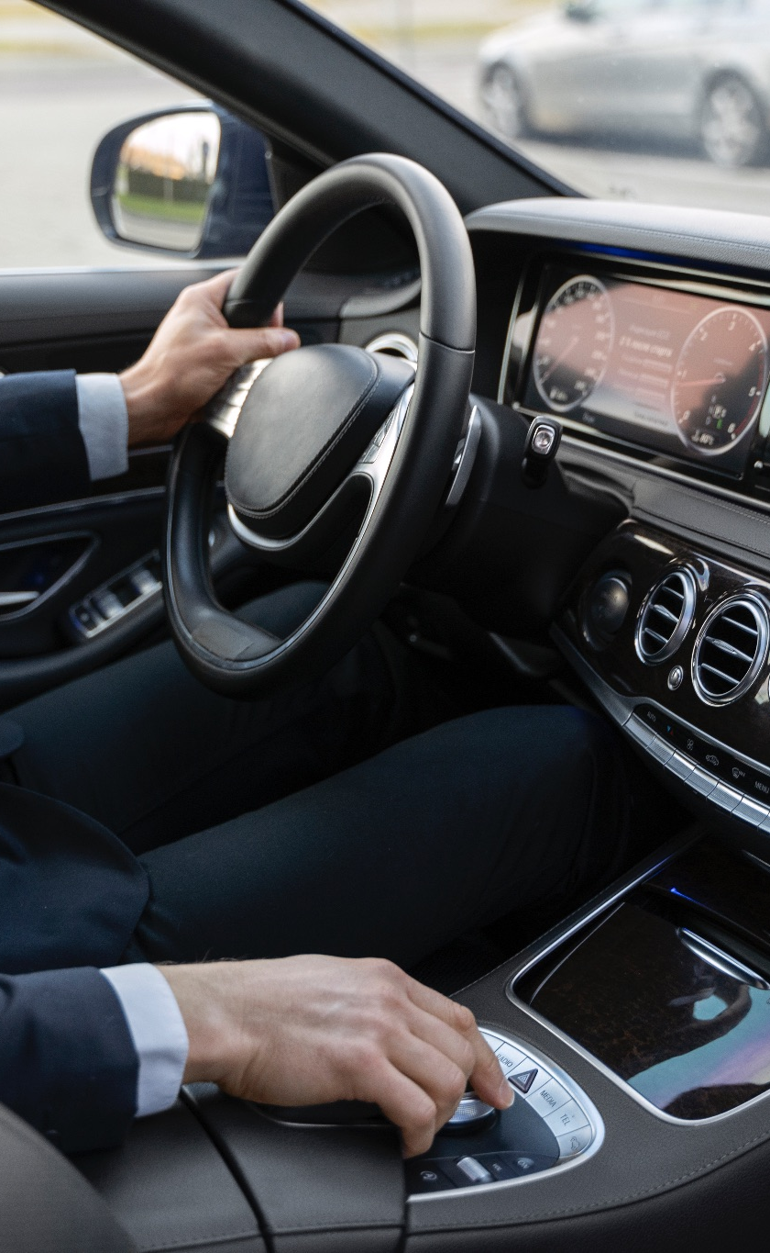
Problem Case
A used car sales company in Saudi Arabia wants to make a machine learning to predict the price of used cars that its customers want, so the potential customers can estimate the budget they have to prepare.
Notes:
At this milestone I define the issue into A used car sales company in Saudi Arabia wants to make a machine learning to predict the price of used cars that its customers want, so the potential customers can estimate the budget they have to prepare.

Slide 5

02
About Data

Slide 6
About Data
Source : https://www.kaggle.com/datasets/turkibintalib/saudi-arabia-used-cars-dataset
Data Shape : 8035 rows and 13 columns
Missing Value : 0
NaN Value : in column Negotiable and Price
Notes:
I took the dataset from Kaggle with the link displayed on your screen.
raw data has shape eight thousand thirty five rows and thirteen columns. There are no missing values, but there are NaN values ​​in the negotiable and price columns. This happens if the buyer buys at a negotiated price, then the price column will be NaN and the negotiable column will contain the negotiated price

Slide 7
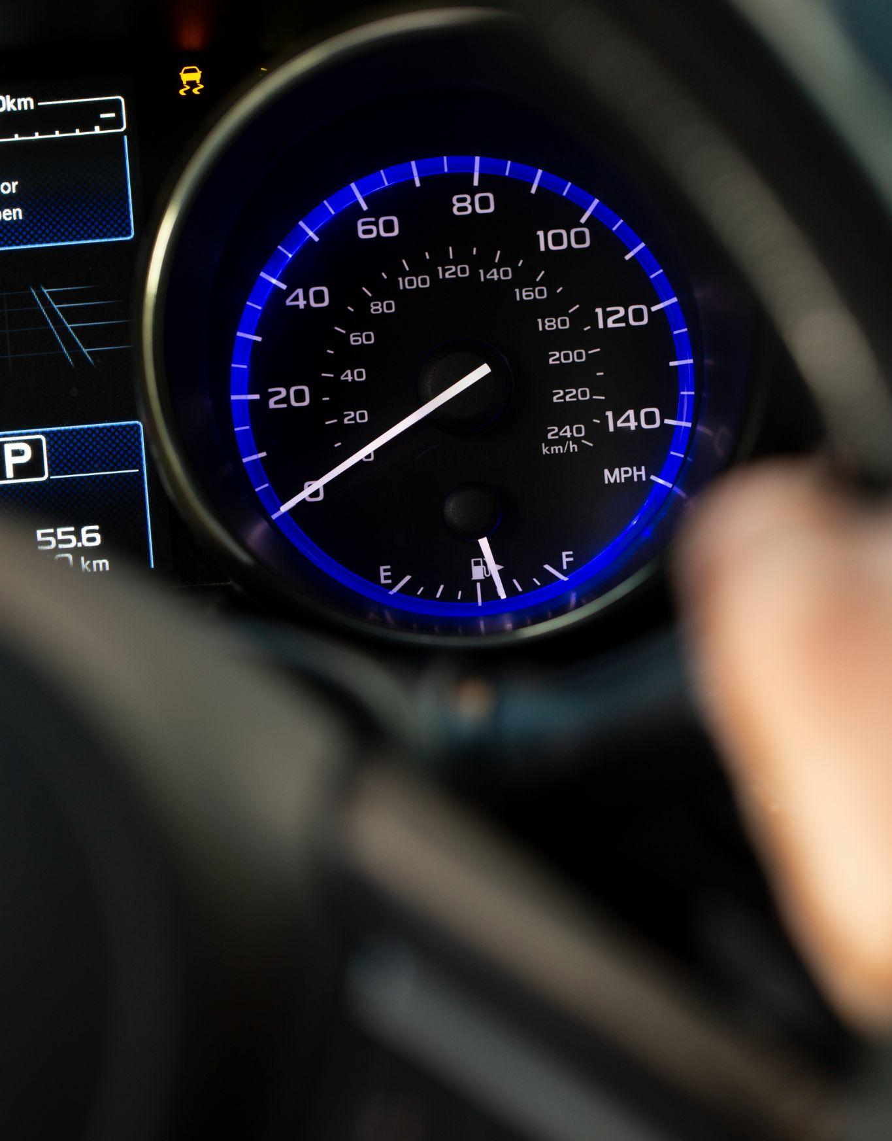
03
Exploratory Data Analysis

Slide 8
TOP 10 Used Car Brand
Notes:
just like in Indonesia, used car brands in Saudi Arabia are dominated by Toyota with one thousand two hundred and sixty two cars, then Hyundai, Ford, Chevrolet, Nissan, Kia, Mer-c, GMC, Lexus, and Mazda. Toyota has a good brand image in the market, because its products are reliable, good after sales service and competitive prices

Slide 9
Gear Type Comparison
Notes:
in gear type comparison, Automatic transmission is the majority with four thousand nine hundred thirty three cars and Manual five hundred and seventy three.
This shows that the people of Saudi Arabia prefer cars with automatic transmission because easier to drive, less tiring, and can be used by all people types.

Slide 10
Average Price
Median Price
Relational Between Price and Brand
Relational Between Price and Gear Type
78334.94024700327 SAR
58000.0 SAR
F-statistic: 54.820156292936446 P-value: 0.0
F-statistic: 81.91120516754067 P-value: 1.9389688498860726e-19
Notes:
The price column has a mean of seventy eight thousand three hundred thirty four riyals and the median is fifty eight thousand riyals.
The price and brand columns have a strong correlation, like the price and gear type columns

Slide 11
04
Data Pre-Processing

Slide 12
Data Pre-Processing
1
Cardinality
2
Handling Outlier
Method: Len Unique Value
Result:
Method: IQR and Gaussian
Result:
Column Name | Unique Value
Brand | 57
Type | 352
Origin | 4
Color | 15
Options | 3
Fuel Type | 3
Gear Type | 2
Region | 27
Column Name | Skewness Score
Year | -1.342547
Engine Size | 0.622364
Mileage | 1.112694
Negotiable | 0.000000
Notes:
In cardinality I count unique value every column and the result is there are 4 High cardinality columns, and 4 low cardinality columns too.
For handling outlier I used IQR and Gaussian Method, the result is the data still skewed.

Slide 13
Data Pre-Processing
3
Feature Selection (Categorical Column)
4
Feature Selection (Numerical Column)
Feature Transformer
(Numerical Column)
5
Method: Anova
Result:
Method: Spearman
Result:
Method: MinMax Scaler
Column Name | Interpretation
Brand | Correlated
Type | Correlated
Color | Correlated
Options | Correlated
Fuel Type | Correlated
Gear Type | Correlated
Region | Correlated
Column Name | Interpretation
Year | Correlated
Engine Size | Correlated
Mileage | Correlated
Negotiable | Correlated
Feature Transformer (Categorical Column)
6
Method: Ordinal Encoder
Notes:
In Feature selection I used Anova and Spearman method, the result shown that all feature correlated.
For Feature Transformer I used MinMax Scaler (because the data still skew) and Ordinal Encoder (because there is ordinal data in options column)

Slide 14
Model & Deployment
05

Slide 15
Comparison Model Result
Model | RMSE | R2 Score
Random Forest | 41016.734723 | 0.699105
Decision Tree | 50978.837084 | 0.535194
KNN | 62446.768933 | 0.302551
SVR | 77029.583032 | -0.061225
XGboost | 35915.079353 | 0.769301
XGboost Tuned | 33550.130368 | 0.798683
Notes:
We tried to 5 type of model, but the result shown the best model is XGBoost , so I tuned XGBoost model and the result is a bit improvement, but improvement is still improvement, so I used XGBoost after tuning for deployment in huggingface

Slide 16

Scan Me!
Scan the barcode for open my HuggingFace page
Or click this HuggingFace Link
Notes:
On your screen there is a barcode. please scan the barcode to connect you to my huggingface page.
(OPEN HUGGING FACE)

Slide 17
Conclusion
06
Notes:
The last section is conclusion

Slide 18
The best model I used is Tuned Extreme Gradient Boost (XGBoost Tuned) Regression with a RMSE score = 33550.130368 and an R2 score = 0.798683
XGBoost Tuned has a Training Score: 0.988 and Testing Score: 0.7693, the model still overfitting.
For the next improvement, We need to Data Balancing, add data, and select more accurate parameters to overcome overfitting.
Notes:
The conclusion are;
The best model I used is Tuned Extreme Gradient Boost (XGBoost Tuned) Regression with a RMSE score = thirty three thousand five hundred and fifty and an R2 score = zero point seven
XGBoost Tuned has a Training Score: zero point nine and Testing Score: zero point seven, the model still overfitting
For the next improvement, We need to Data Balancing, add data, and select more accurate parameters to overcome overfitting.

Slide 19
Thanks!
Any questions?
Daniyal Kahfi
@kahfidaniyal

